Slide 1
Heart strock prediction
Guided by : Dr.Jignesh Doshi
Himali Kamleshbhai Banda : 21004500210188
Sakshi Patel Parikshitbhai : 21004500210211
Roshani Sachdev Chanreshbhai : 21004500210222

Slide 2
Introduction
Stroke is one of the leading causes of death and disability worldwide. Early detection of stroke risk factors can help prevent severe health complications and save lives.
In this project, we leverage machine learning techniques to predict the likelihood of a person experiencing a stroke based on various health parameters.
Using a dataset containing patient health records, we will explore key factors such as age, hypertension, heart disease, BMI, and lifestyle habits.
The goal is to develop an accurate predictive model that can help in early diagnosis and prevention.

Slide 3
Data Source

Slide 4
Objectives:
Perform data preprocessing and exploratory data analysis (EDA).
Identify key risk factors contributing to stroke occurrence
Train and evaluate machine learning models to predict stroke risk.
Optimize model performance for better accuracy and reliability.

Slide 5
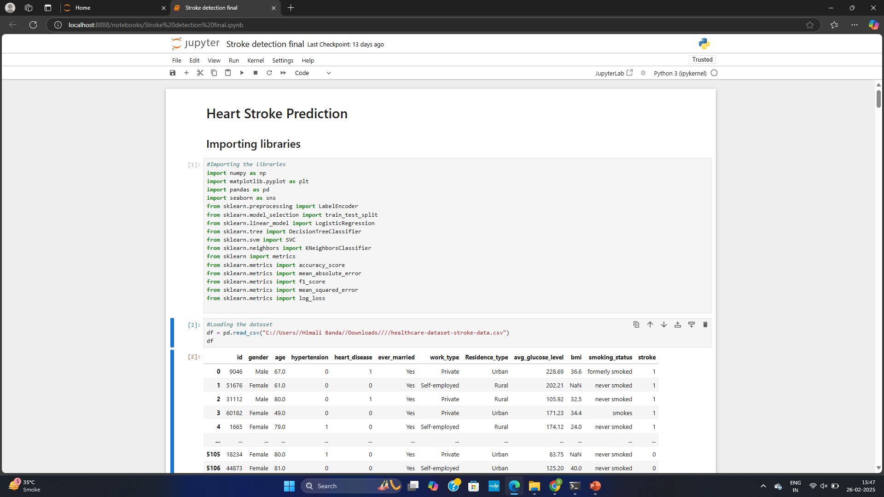
Import Libraries

Slide 6
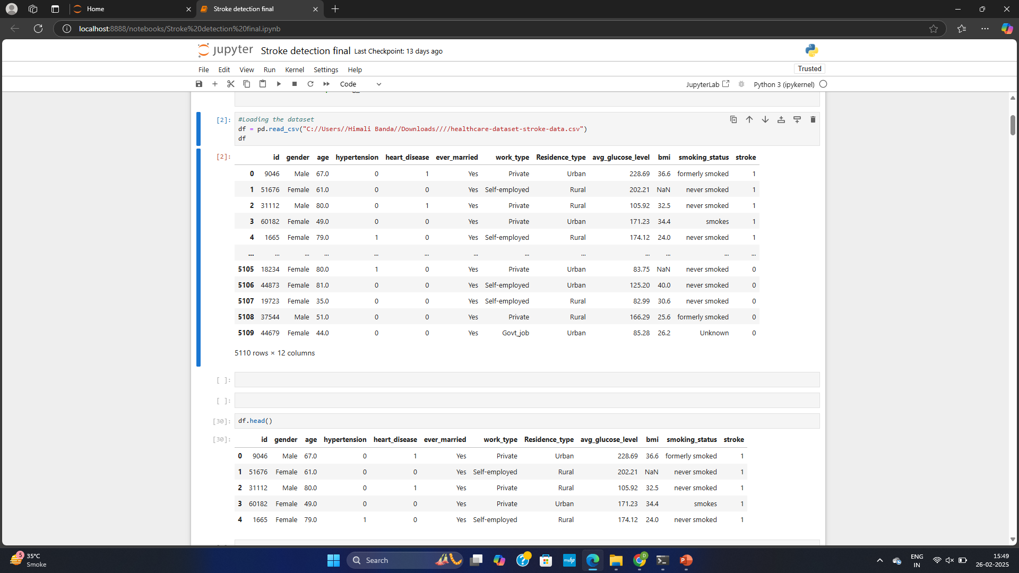
Load the csv file

Slide 7
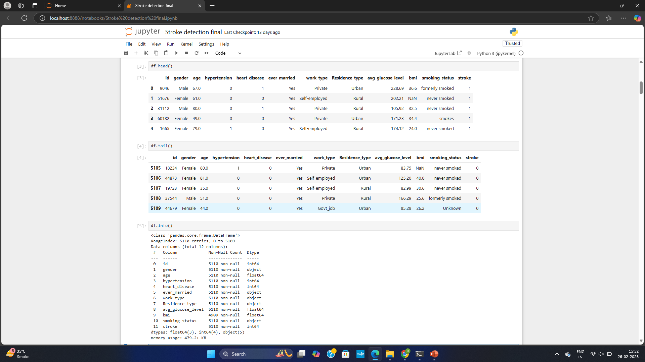
Top and Bottom data

Slide 8
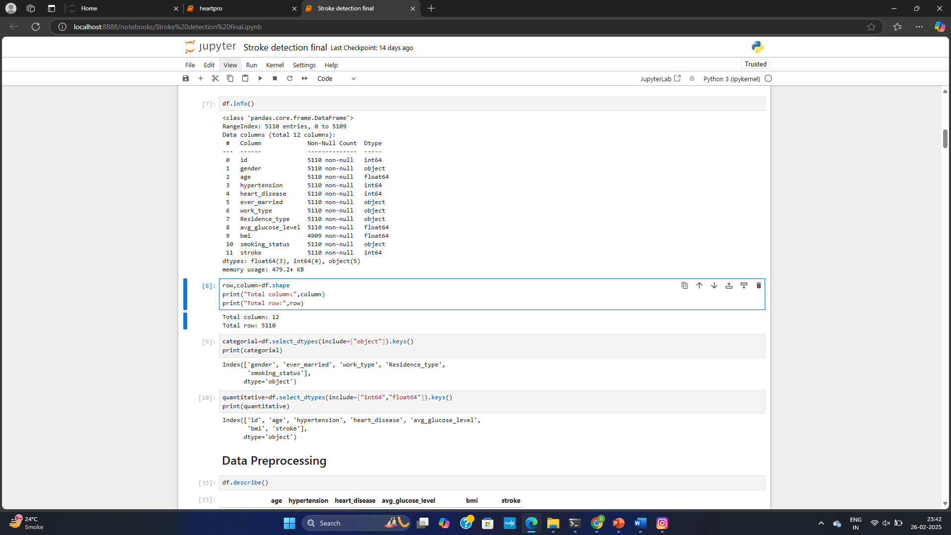
Data Volume

Slide 9
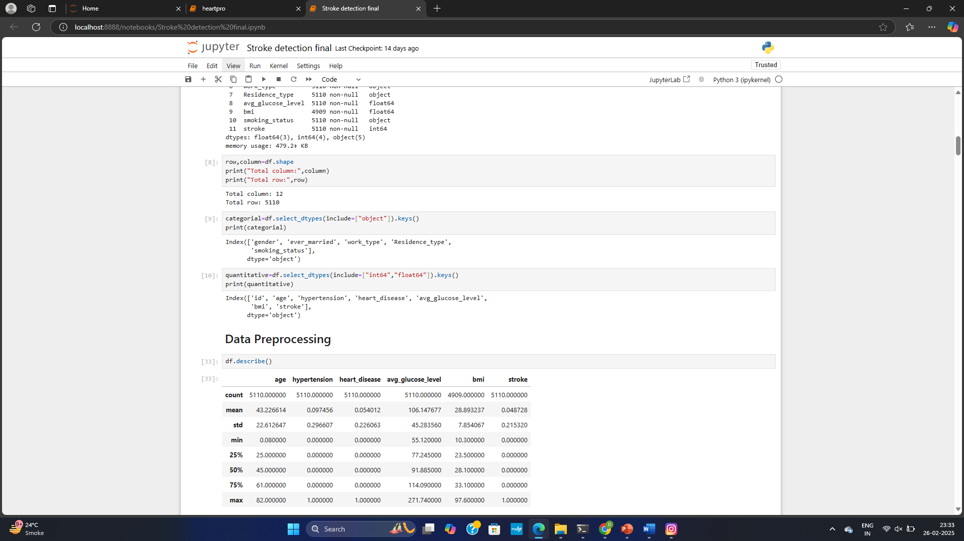
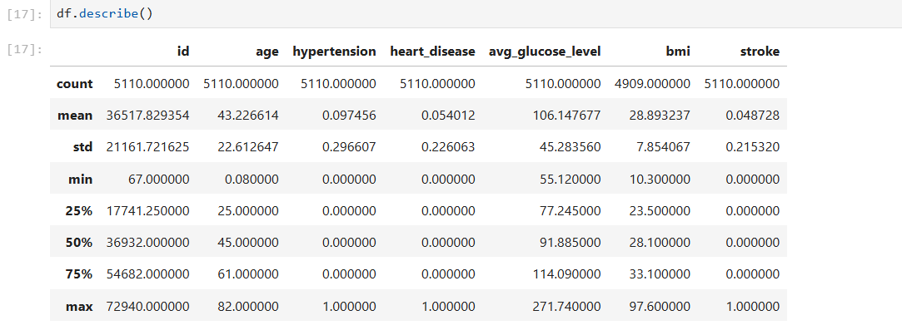
Encoding categorial variables

Slide 10
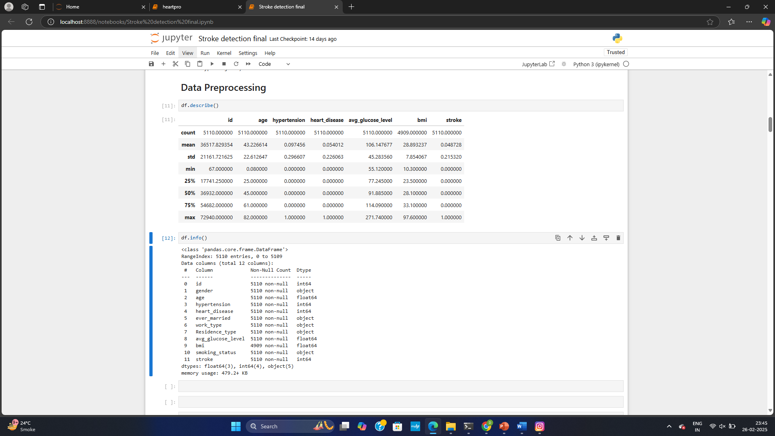
Data Summary

Slide 11
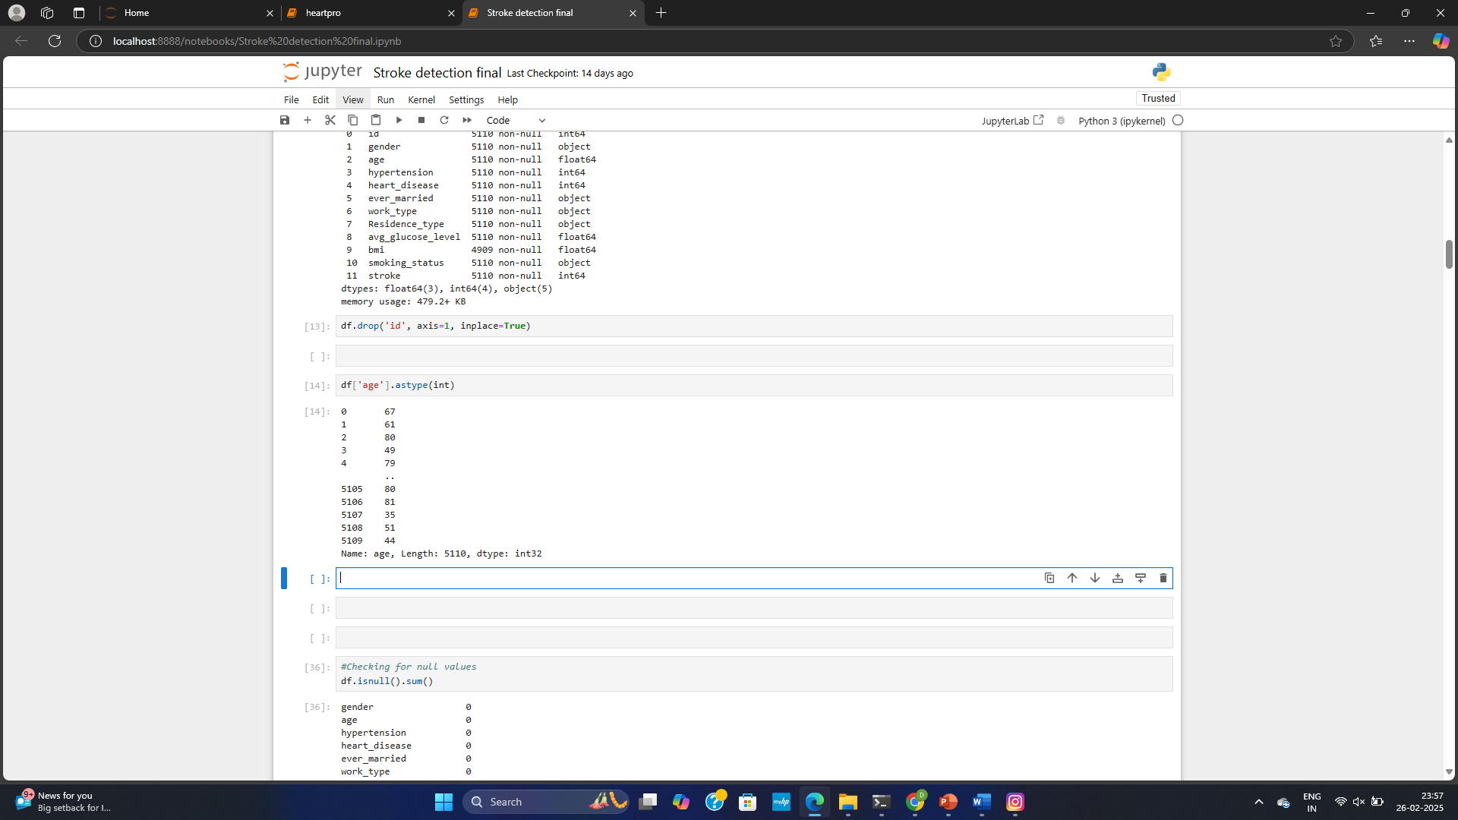
Converting Data type

Slide 12
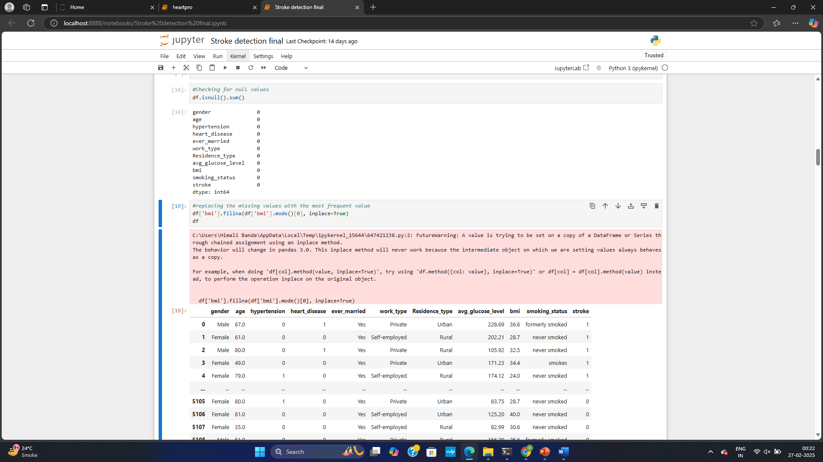
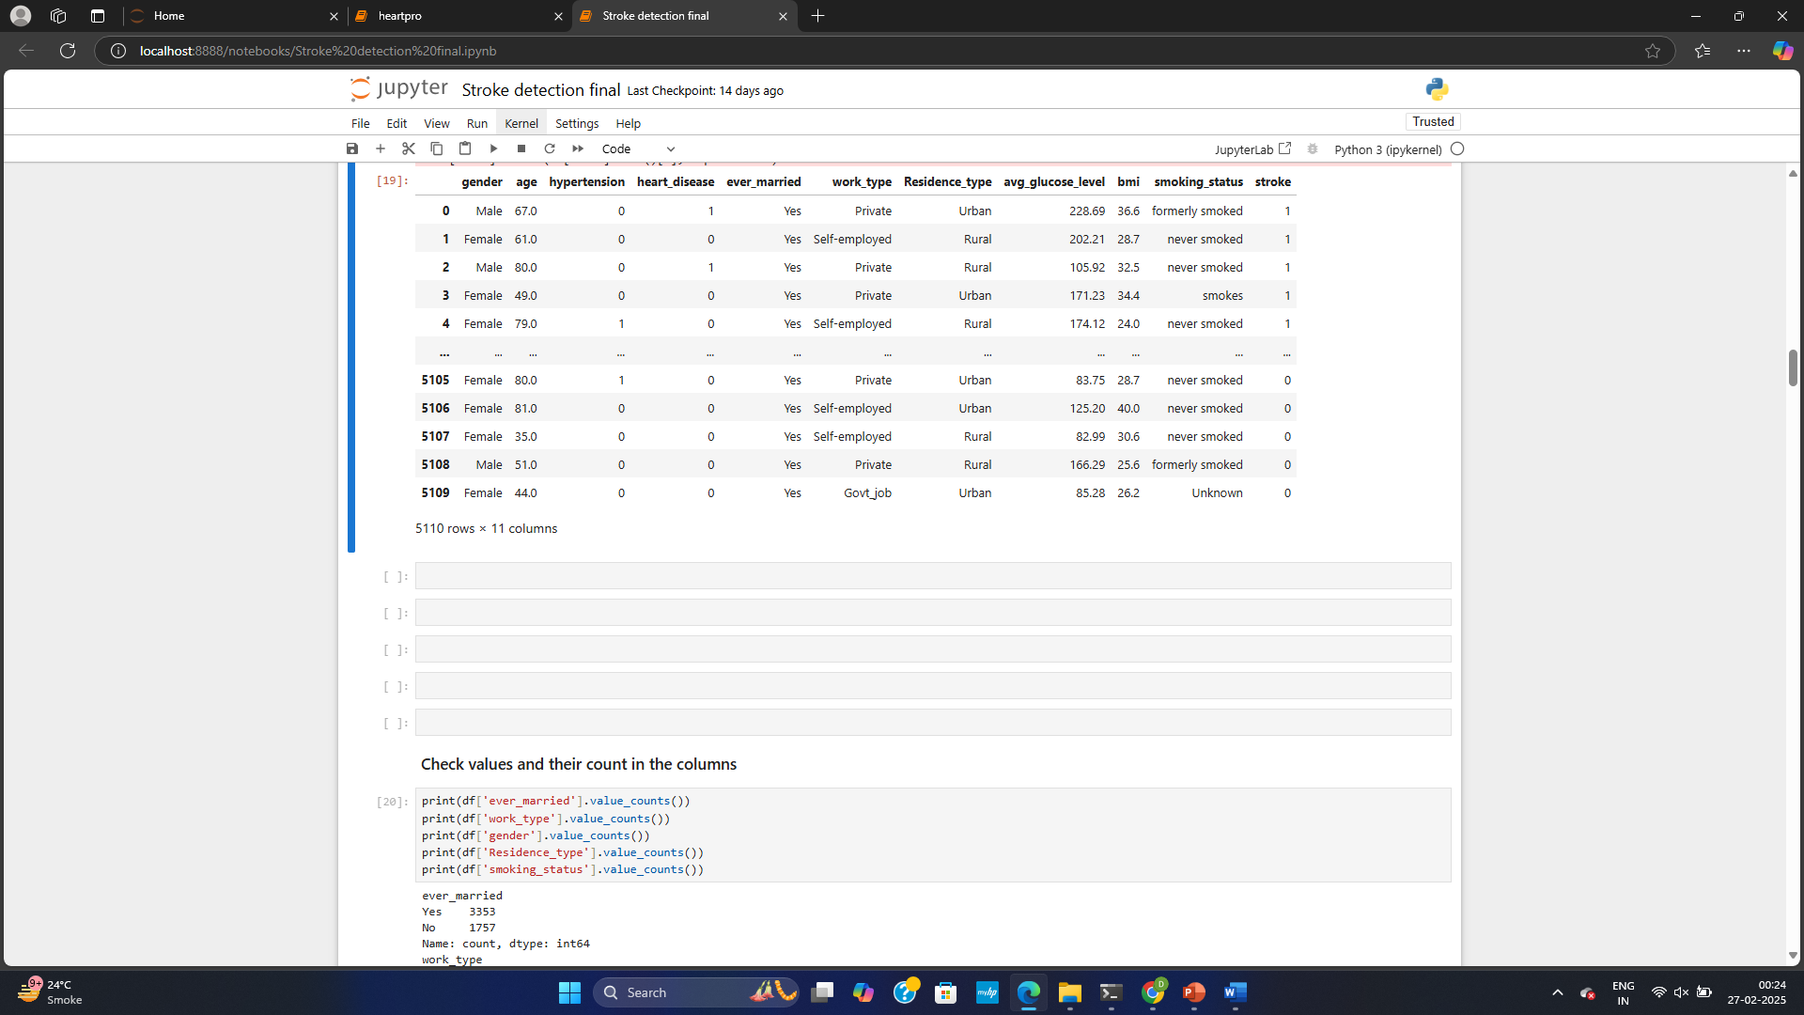
Handling missing values

Slide 13
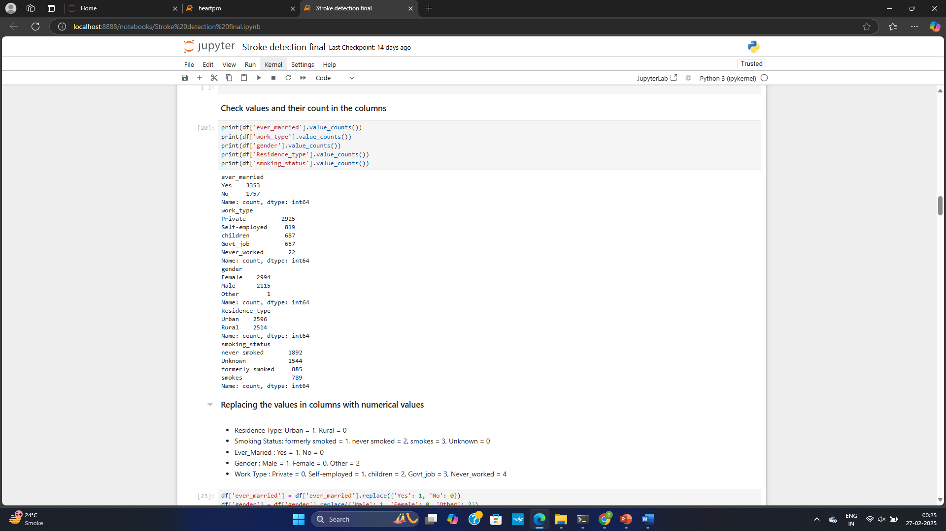
Check values and counts

Slide 14
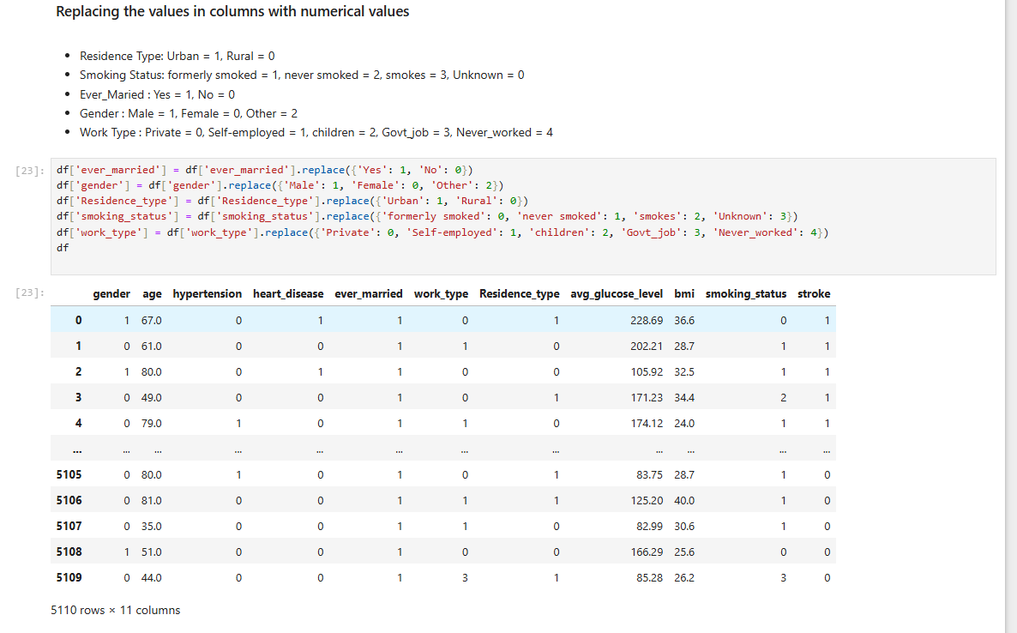
Replacing values with numerical

Slide 15
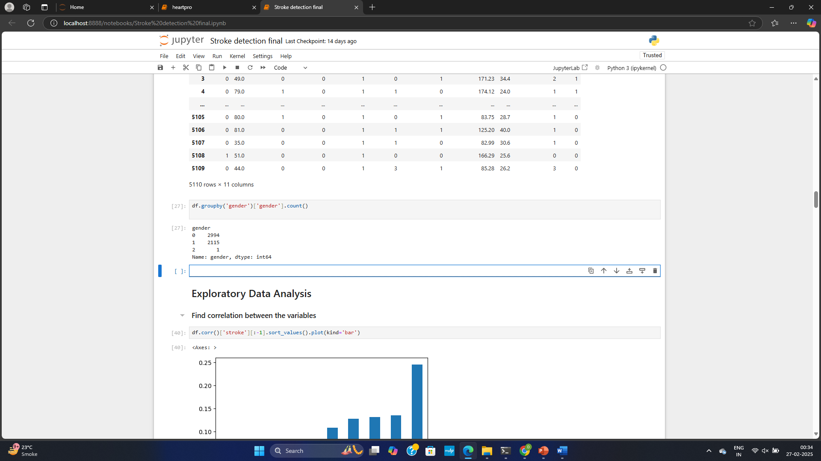
Compare rows using group by

Slide 16
Exploratory Data Analysis
Descriptive statistics, such as mean, median, and standard deviation, are computed to summarize the data. Correlation matrices reveal relationships between variables.
EDA helps uncover hidden patterns and potential biases in the data. The insights gained guide subsequent modeling steps.

Slide 17
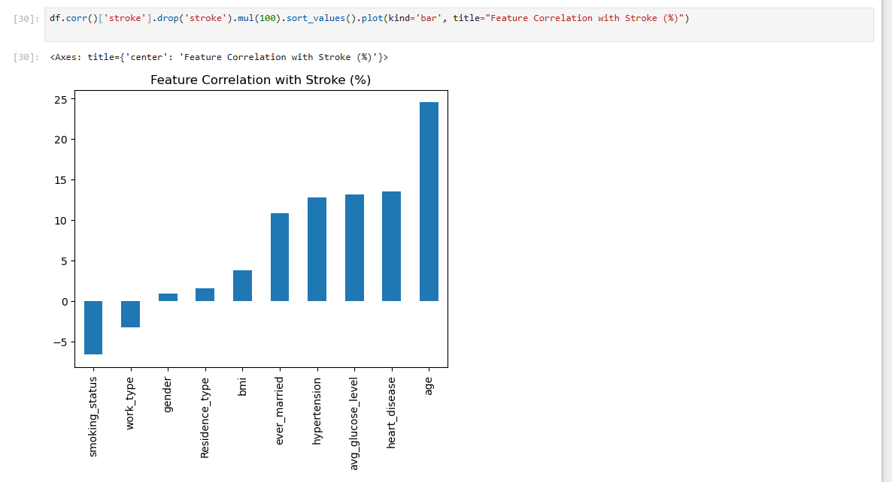
Find correlation between variables

Slide 18
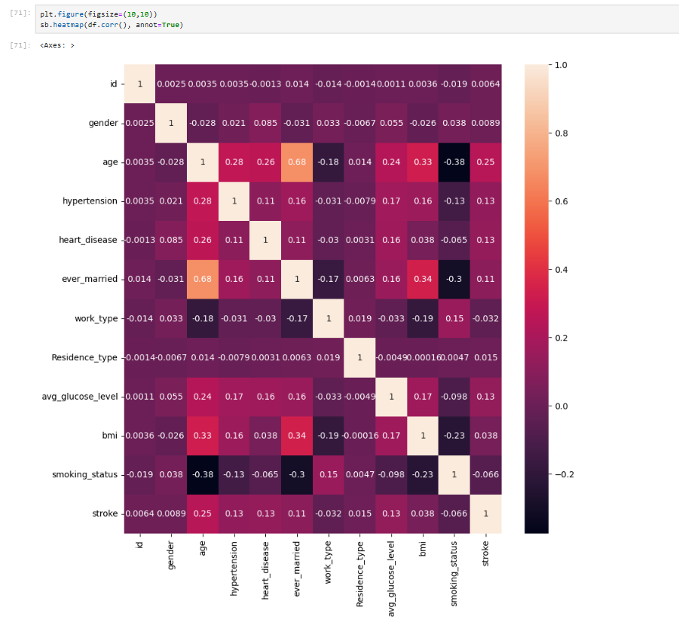
Heap map

Slide 19
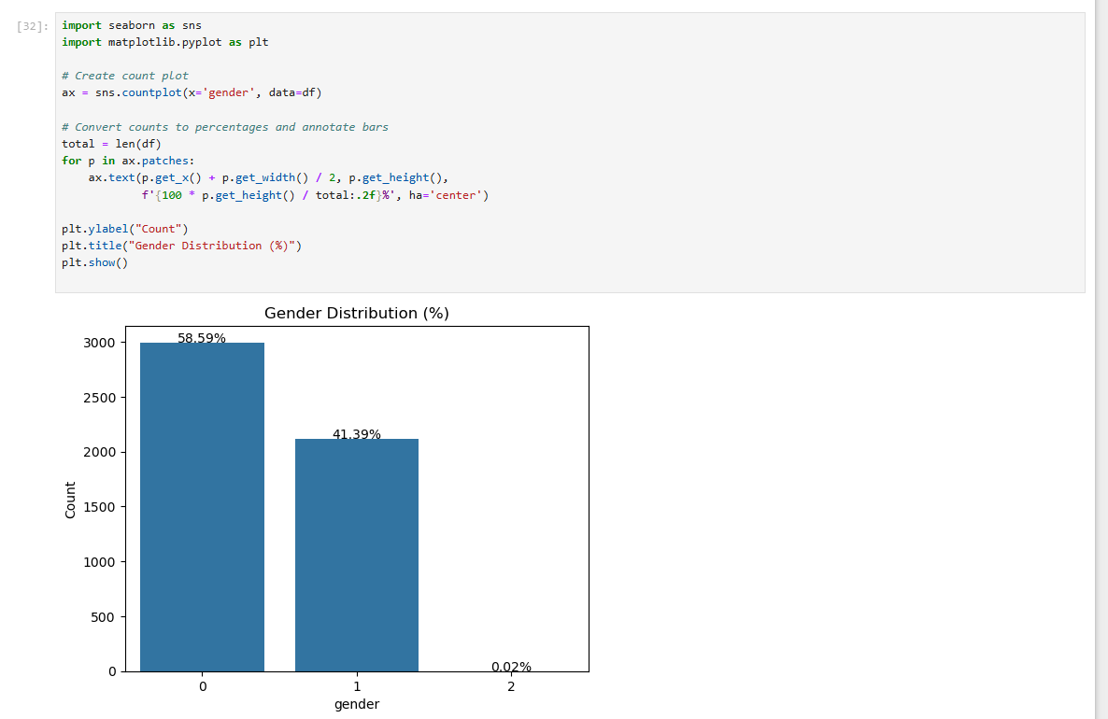
Count Plot

Slide 20
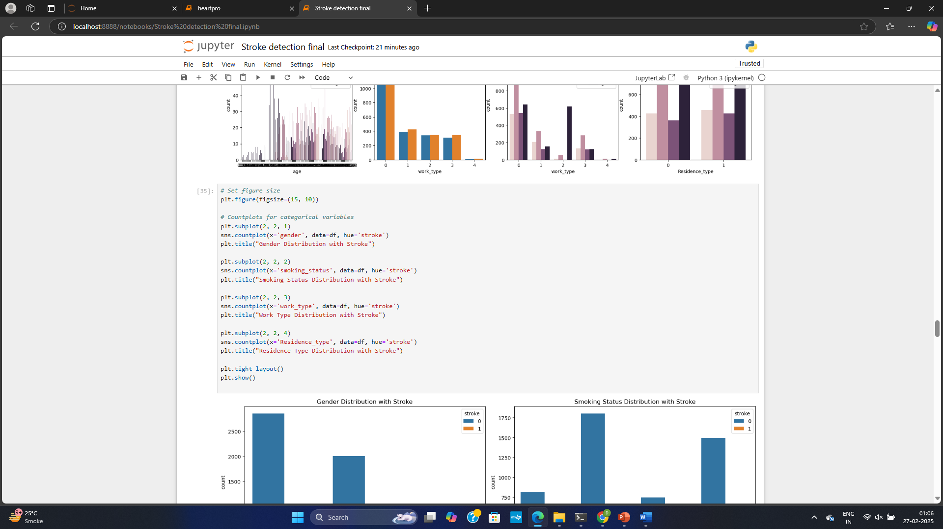
Count plot for categorial variables

Slide 21
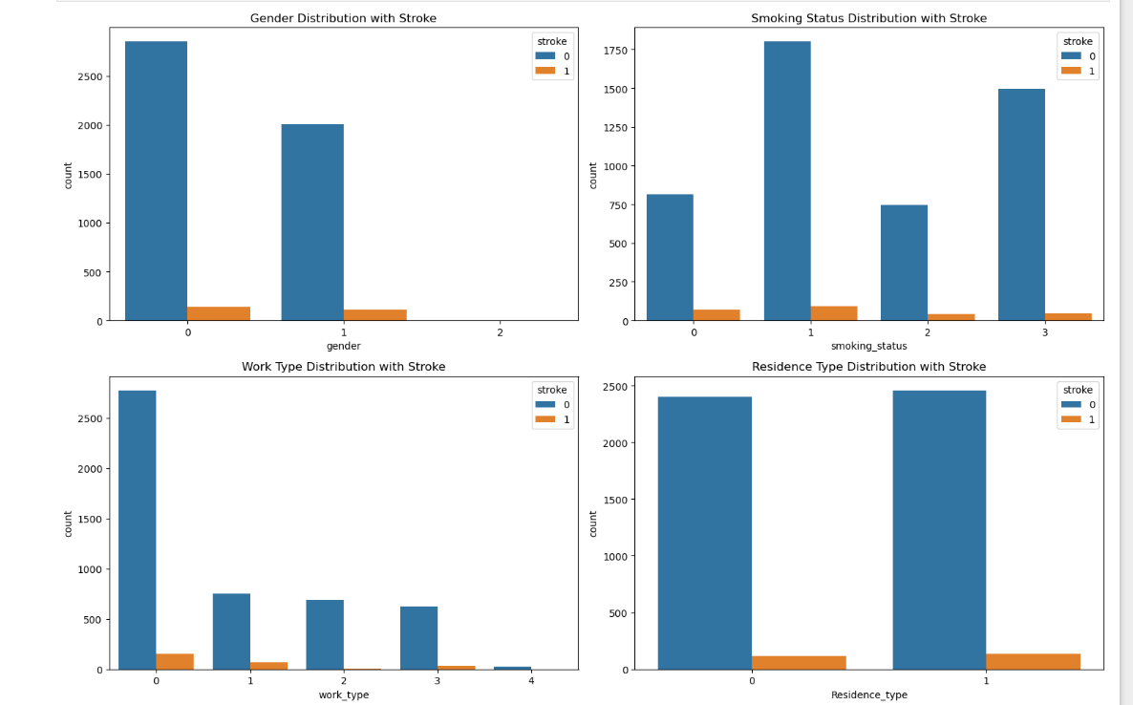

Slide 22
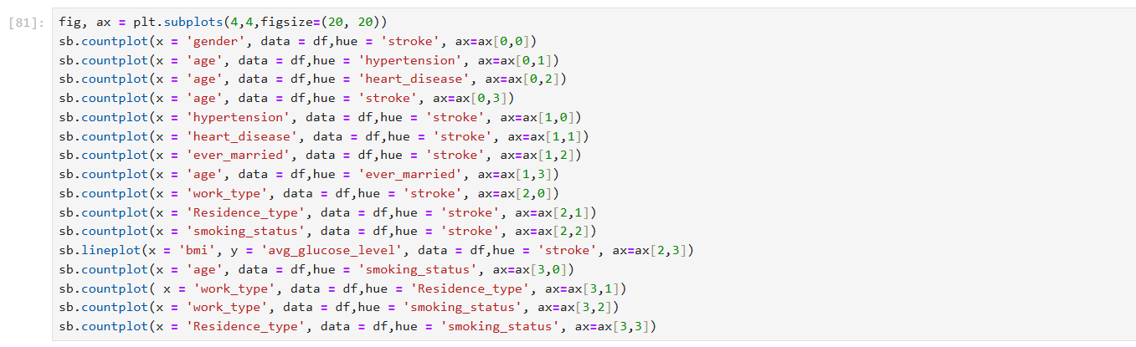
SubPlots

Slide 23
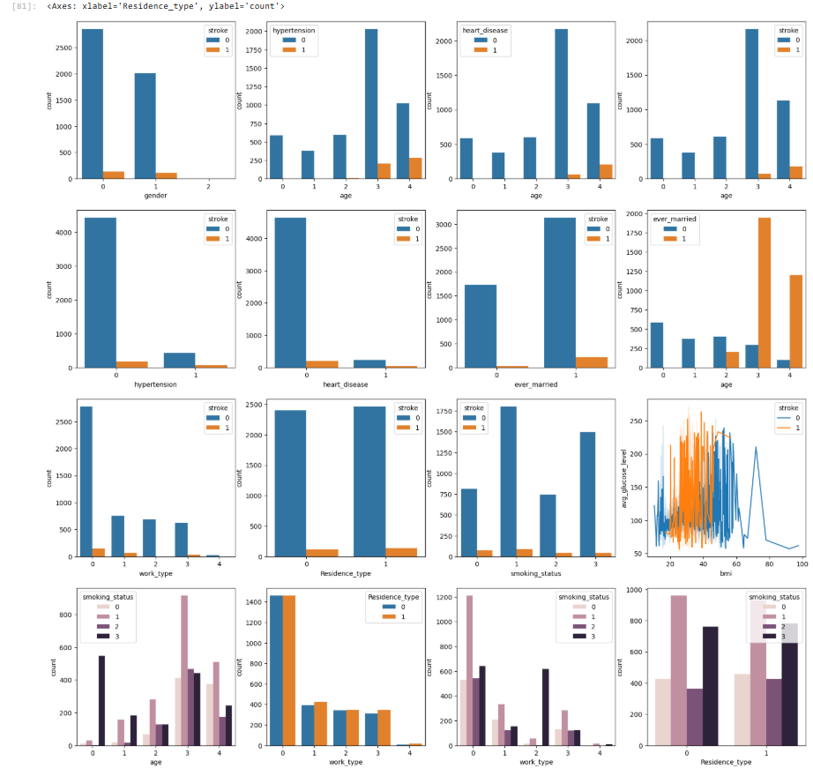

Slide 24
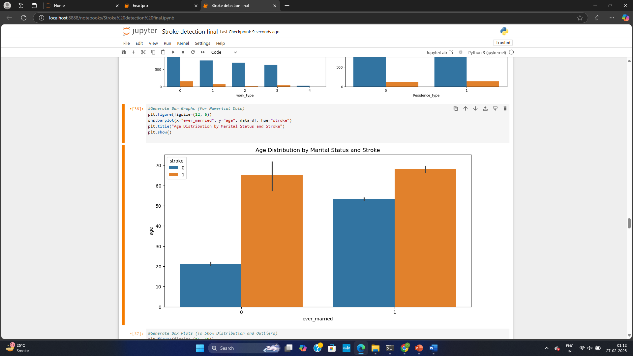

Slide 25
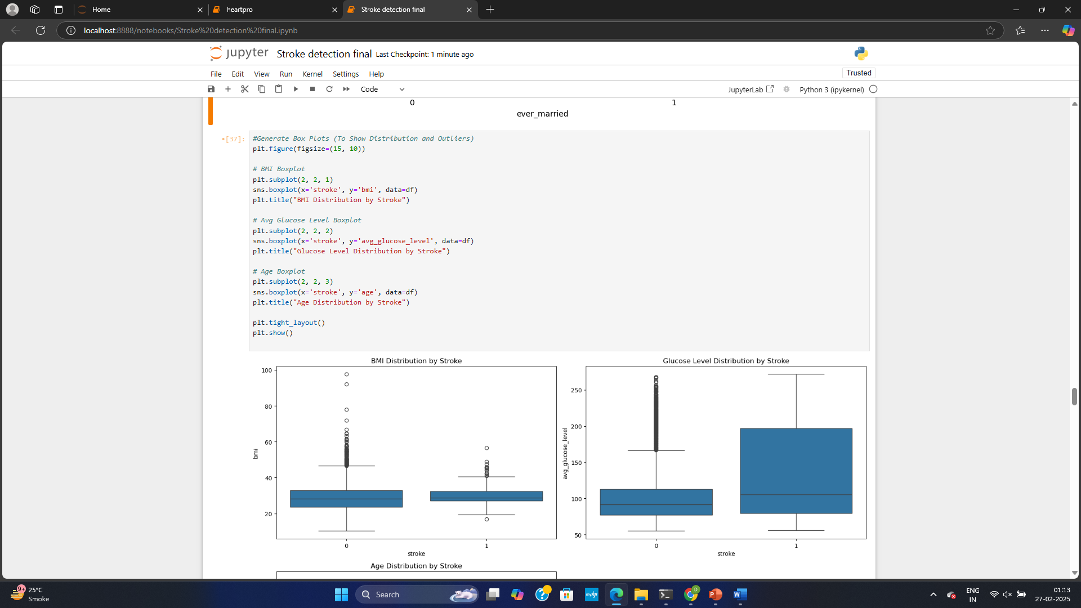
BoxPlots

Slide 26
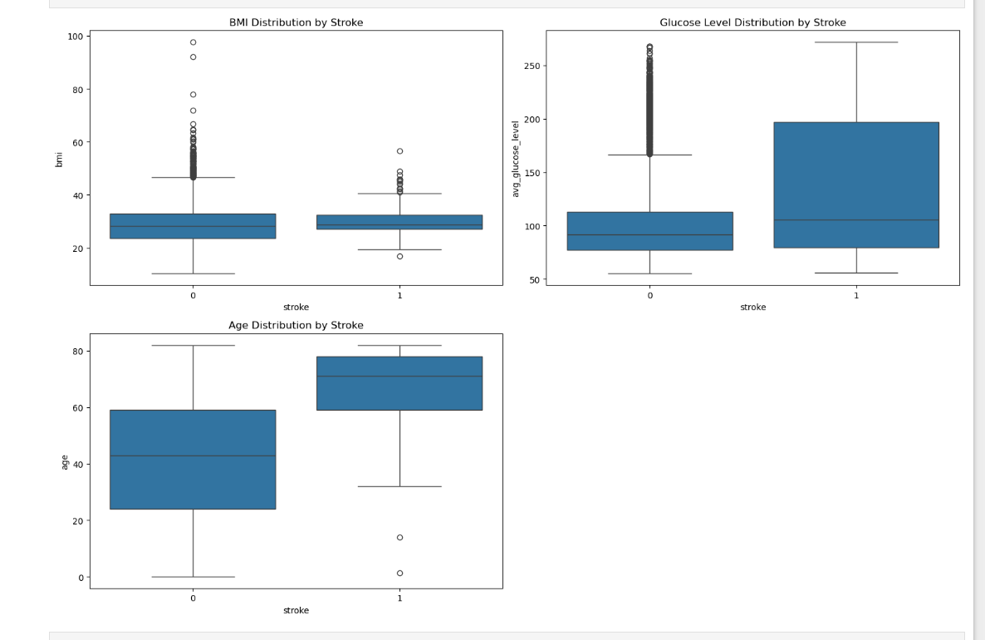
Boxplots

Slide 27
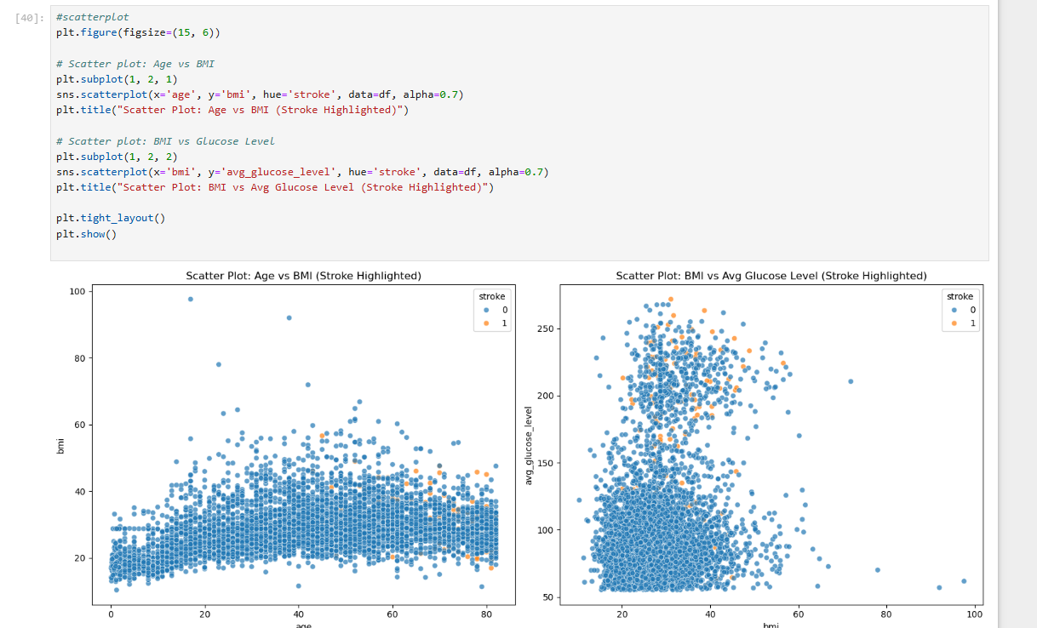
Scatterplots

Slide 28
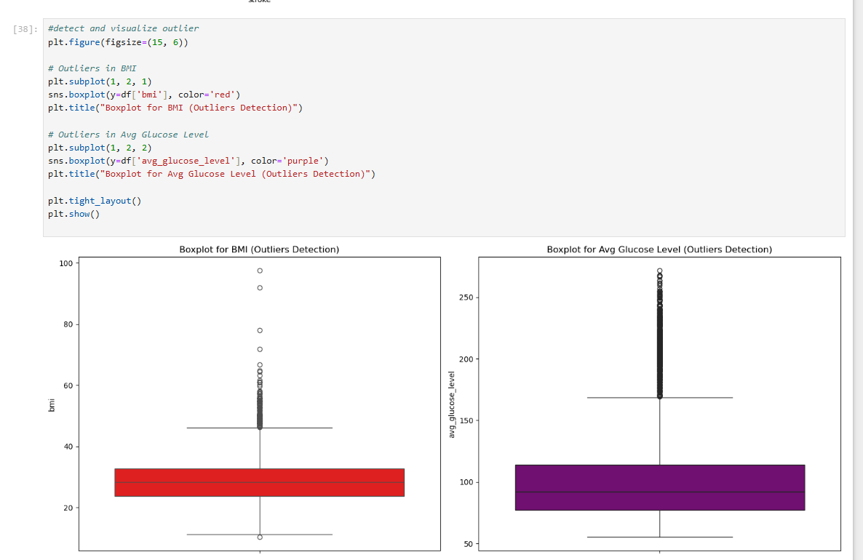
Outlier detection

Slide 29
Train Test Split

Slide 30
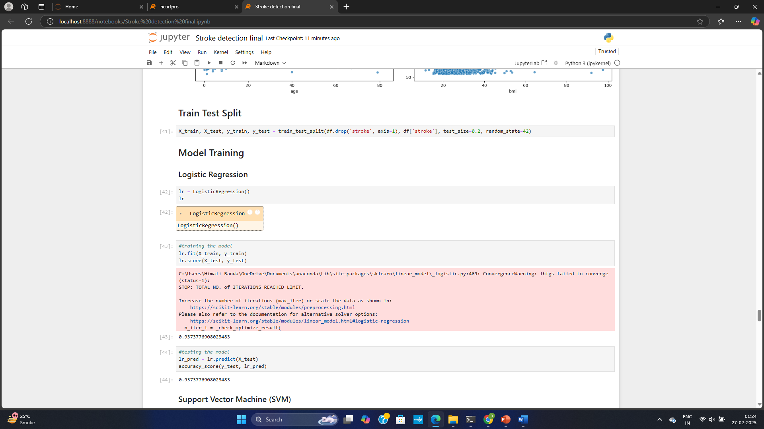

Slide 31
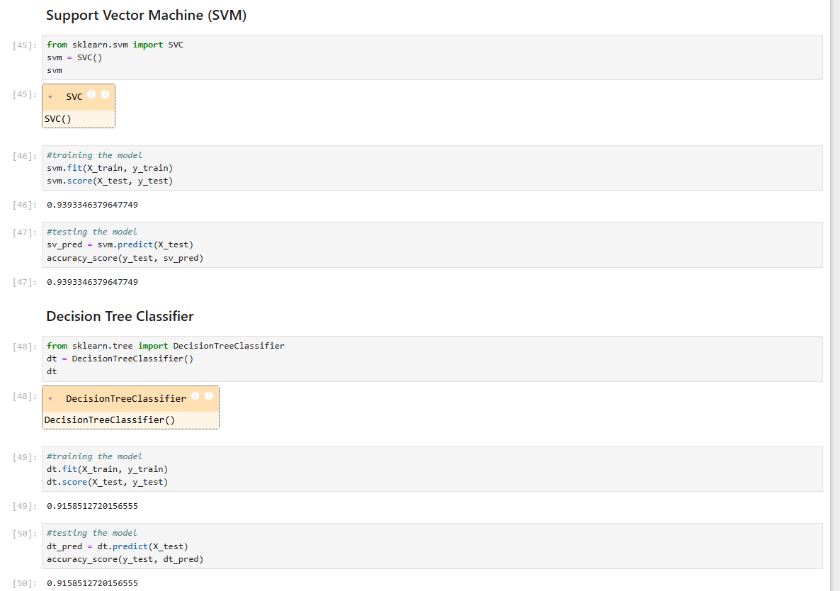

Slide 32
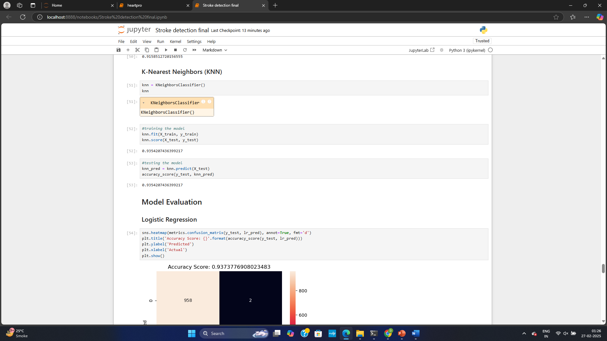

Slide 33
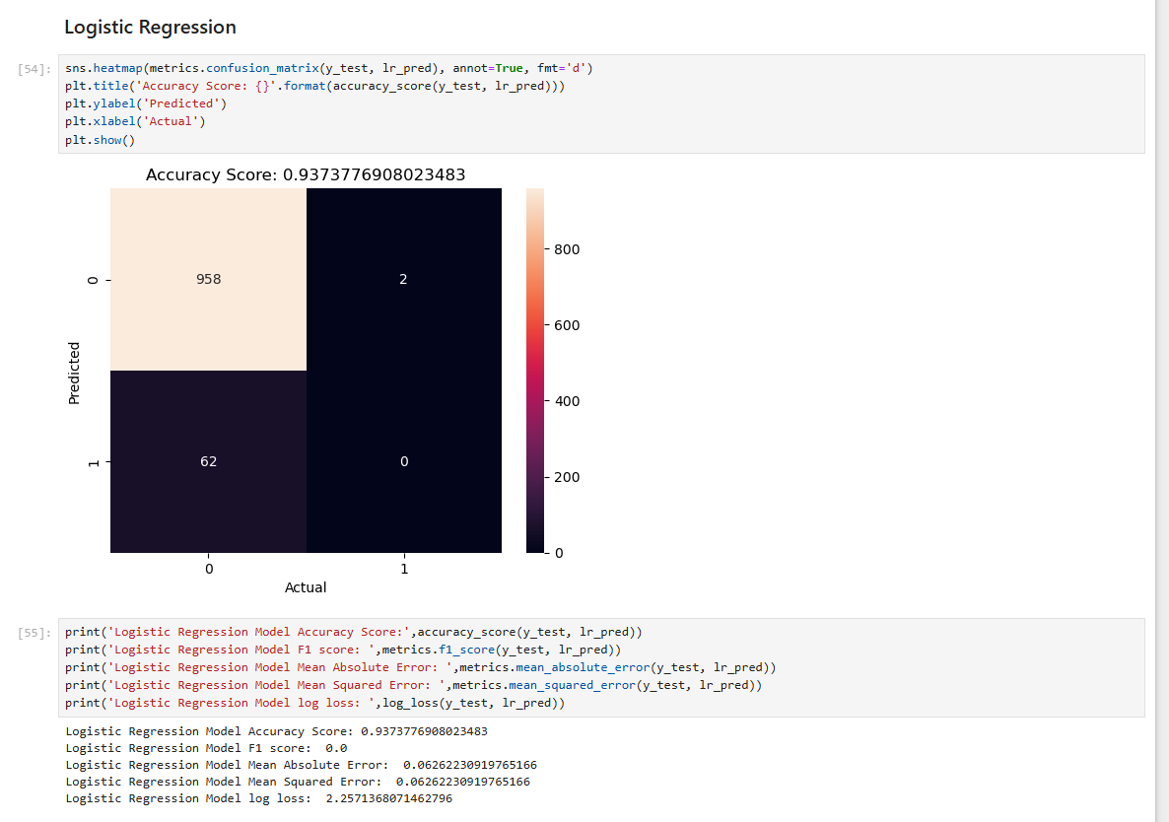

Slide 34


Slide 35
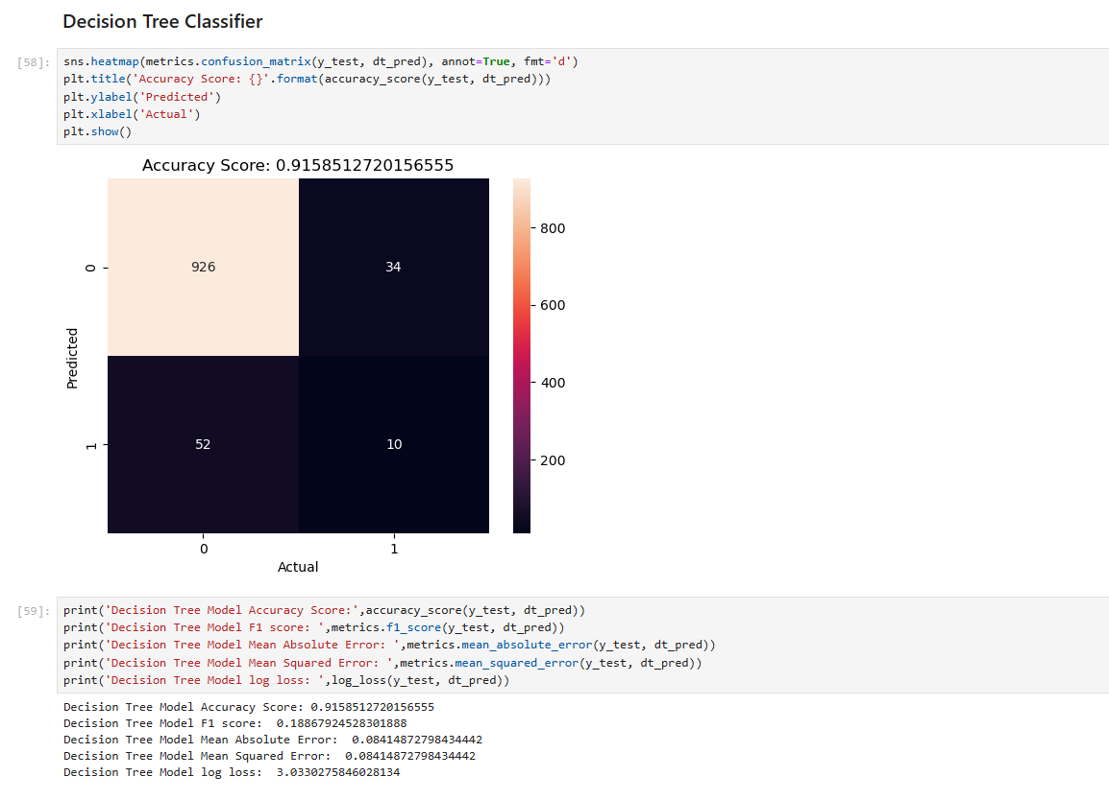

Slide 36


Slide 37
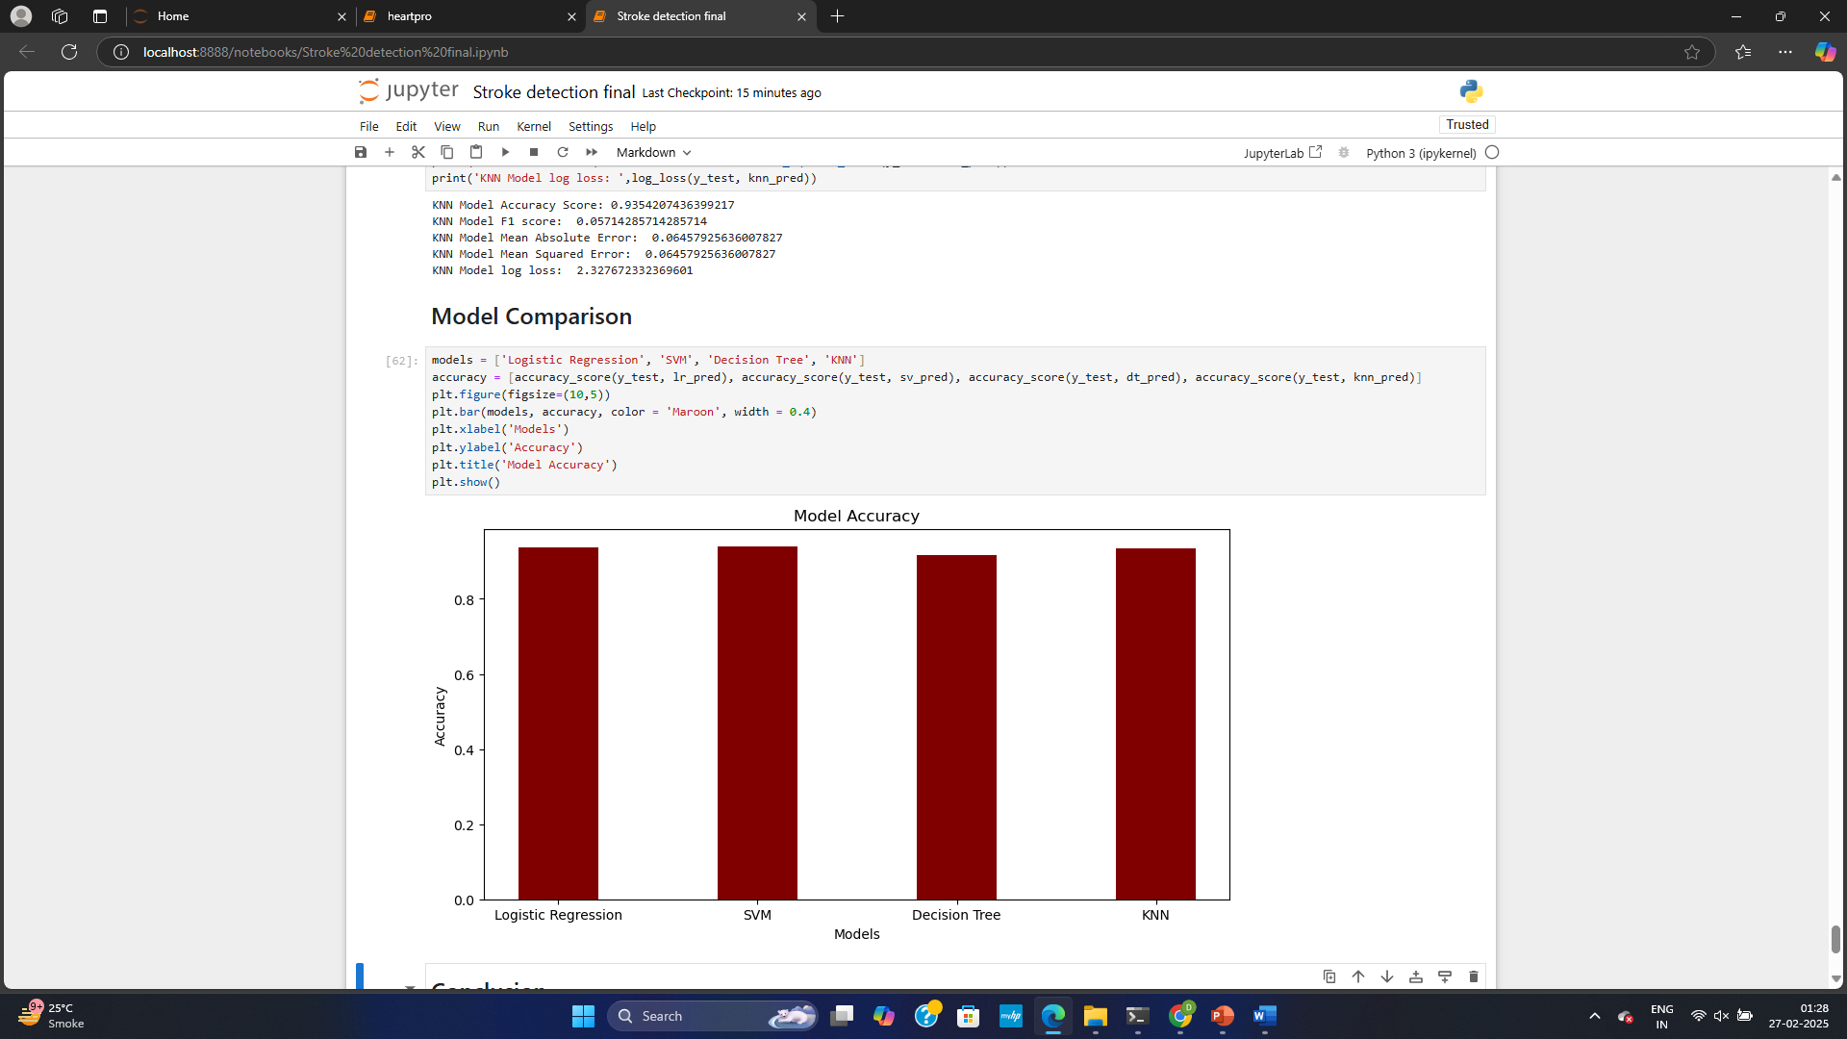

Slide 38
Model Performance
Accuracy scores of different models:
- Logistic Regression: 93.8%
- Support Vector Machine: 93.8%
- K-Nearest Neighbors: 93.8%
- Decision Tree: 91.8%
The best-performing models can be used for stroke prediction

Slide 39
Conclusion:
The model accuracies of Logistic Regression, SVM and KNN are quite similar i.e. 93.8 %. The accuracy of Decision Tree Classifier is 91.8 %. So, we can use any of these models to predict the heart stroke.
According to the graphs age v/s hypertension, heart disease showing chances of stroke, the number of person having a stroke shows dependence upon heart disease and hypertension.
But when we plot the graph of heart disease and hypertension against the stroke, the persons with lower chances of hypertension and heart disease has increased chances of stroke.
This is a peculiar thing and needs to be investigated further. In addition to that non smokers have higher chances of stroke than smokers.
This is also a peculiar thing and needs to be investigated further. However person having BMI between20 to 50 have higher chances of stroke.
Last but not least other features such as martial status, residence type as well as work type are showing effect on the chances of stroke

Slide 40
Thank You

